Slide 1


Utah Division of Water Rights
Water Use Groups
RWAU Training—April 2018
Eric Jones, P.E. Teacher
June 21, 2004

Slide 2
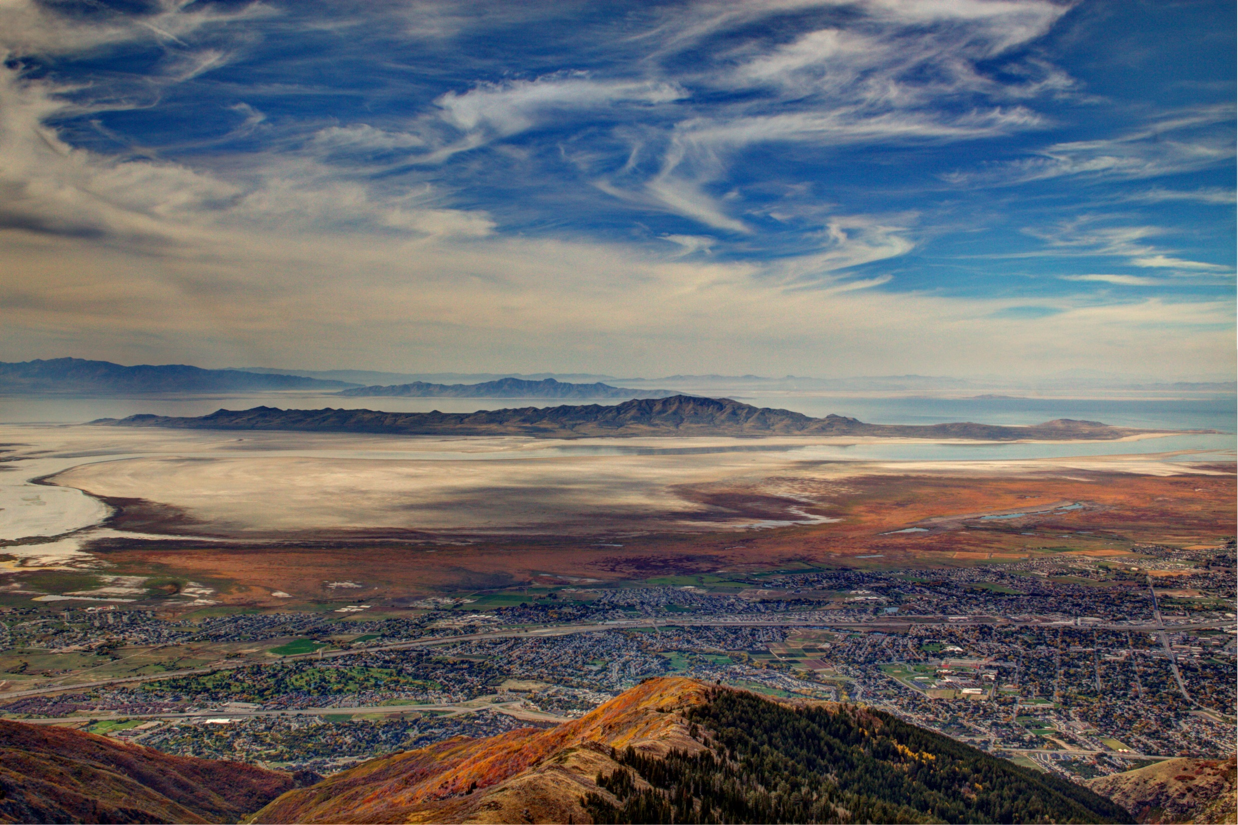
Understanding Water Use Groups
The What, Why, and How.

Slide 3

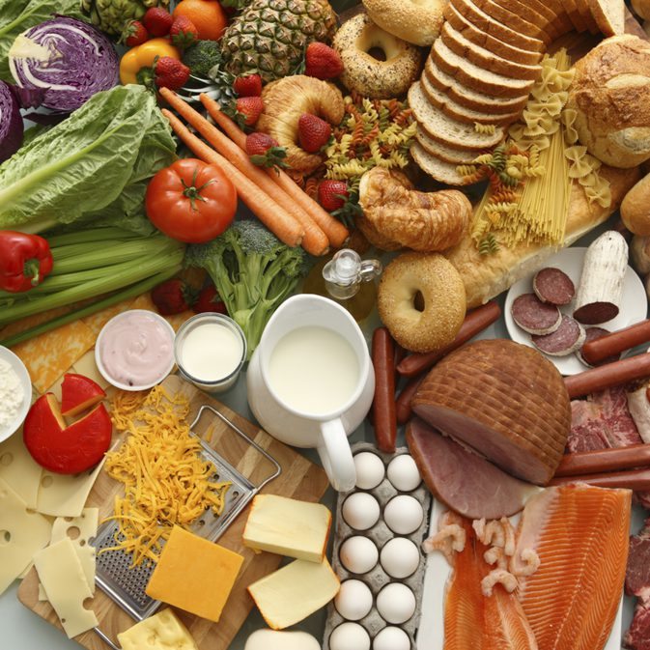
Let’s Talk about food
  Who here eats food?
  What are groups of foods or how can we group foods?

Slide 4
Water Rights are like food
  Water Rights can be grouped together based on common place, period, and type of uses.
  Thought provoking question: If two Water Rights share the same point of diversion should they be in the same water use group?
  Even more thought provoking question: Is a tomato a fruit or a vegetable?

Slide 5
What is a Water Use Group?
  A grouping of Water Right(s) that have a common use at the same place of use.
  A Water Right must belong to at least one water use group.
  Each water use group represents a unique beneficial use of water and ties together the water rights that serve that use.
    Beneficial use is the basis, measure, and limit of a water right.

Slide 6
A Water Use Group Defines
  The place(s) of use
  The period(s) of use
  The beneficial use(s)
  Of one or more water right(s).
  A single water right can belong to more than one water use group.

Slide 7
Place of Use
  The place of use
    Defines the authorized and recognized place of use for the use of water described in the group.
    Should be consistent with the information contained in the State Engineer’s records.
    May include more than one Section or Quarter Section of land

Slide 8
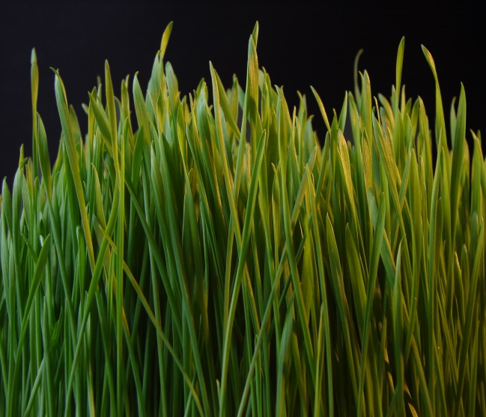
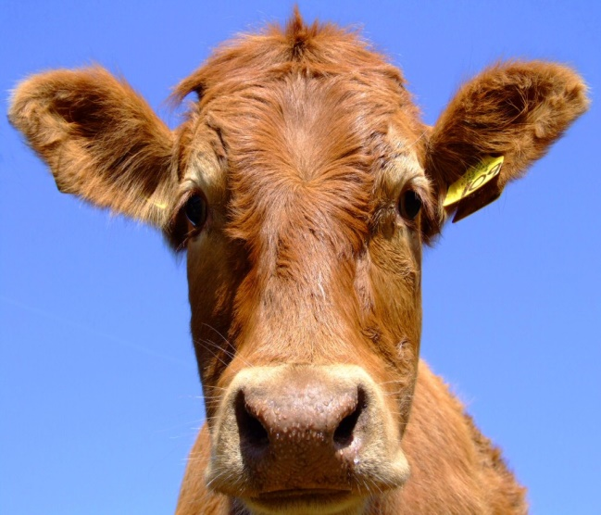
Period of Use
  The period of use
    Is the time period a beneficial use takes place
    Year-round April 1 to October 31 Year-round

Slide 9
Beneficial Use
  The beneficial use is
    is the basis, measure, and limit of a water right.
    What are some types of beneficial use?

Slide 10
Other Terms to Understand
  Sole Supply
    May be expressed as a limit of use of a water right
    May also refer to a water right limit in a group
  Group Total
    The total use in this particular water use group
  Beneficial Use Amount
    The amount of beneficial use a water right contributes to a Water Use Group in which it is included. May be referred to as “Group Contribution”.

Slide 11
Why do we use Water Use Groups?
  To account for the limits and measure of each water right.
  As an index to the water rights that serve a use.
  To uniquely account for all uses of water in the state.

Slide 12
How will you use and interact with Water Use Groups?
  As a key indicator of value when acquiring a right.
  As an issue to be reconciled when changing a right.*
  As a limit to be observed when using a right alone.
  *Since many of the water use groups which relate to more than one water right are not completely quantified you will likely become involved in an effort to complete that work in water right processes.

Slide 13
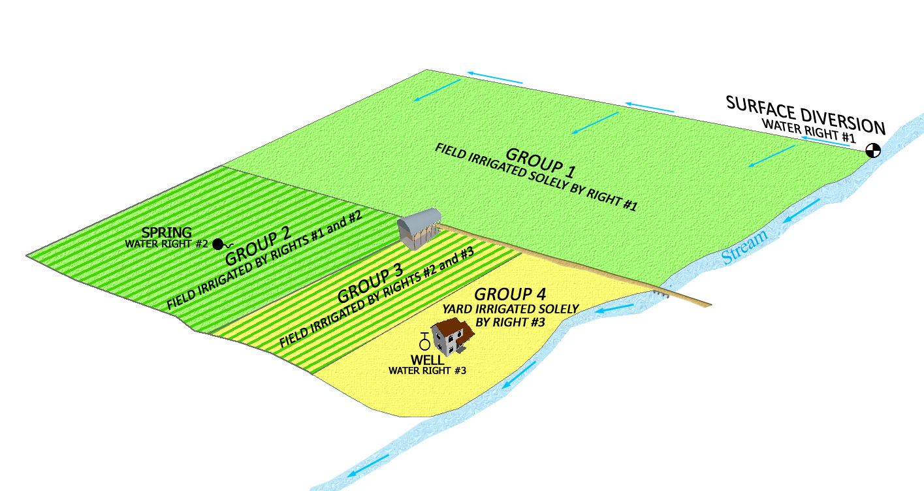

Slide 14
Water Use Groups exercise
 | Water Right #1 | Water Right #2 | Water Right #3
Equivalent Domestic Unit | 1 | 0 | 2
Equivalent Livestock Unit | 15 | 20 | 100
Acres | 3 | 4 | 4
  How many water use groups should there be?

Slide 15
What documents provide information to help clarify what is included in a Water Use Group?
  Information included in a water right file
    Application to Appropriate
    Diligence or Underground Water Claim
    Certificate of Beneficial Use
    Judicial Decree
    Published Proposed Determination Book / Addendum
    Maps (application, claims, certificate, hydrographic survey maps)

Slide 16
Water Use Groups exercise
WR# | Document | Date | Uses
57-1 | App to App Certificate Signed WUC | 8/16/1956 9/30/1960 10/31/1978 | 3 EDUs and 5 ELUs 3 EDUs and 5 ELUs 2.0 acres, 3 EDUs and 15 ELUs
57-2 | Diligence Claim Signed WUC | / /1895 10/31/1978 | 1.0 acre and 5 ELUs 2.0 acres, 3 EDUs and 15 ELUs
57-3 | Signed WUC | 10/31/1978 | 2.0 acres, 3 EDUs and 15 ELUs
  How many water use groups should there be?

Slide 17
Question Time?
  If a water right owner has several water rights for the irrigation of 120 acres and the water rights all describe the same place of use. How should the water use group(s) be structured?

Slide 18

Food Diversion
  Sliced bread was invented in 1912*
  Upon its invention they said, “[sliced bread is] the greatest forward step in the baking industry since bread was wrapped."
  * Mass production of sliced bread started in 1928.

Slide 19
Question Time?
  If a water right owner has several water rights for the irrigation of 120 acres and the water rights all describe the same place of use. An irrigation company provides water in the area. It appears that the water right owner may be able to use water from the irrigation company. How should the water use group(s) be structured?

Slide 20
  A group contains a water right owned by an individual and the water rights for an irrigation company. What does this mean?
    The use described in the group is supplemental to shares of stock in an irrigation company.
    The individual right provides only a portion of the total Beneficial Use Amount.
    The land is within the service area of the irrigation company.
    Shares in an irrigation company are bought and sold as securities and lands served by the company may change.
    This is an error that you can ask the Division to correct. We no longer include irrigation company rights in groups with private rights.

Slide 21
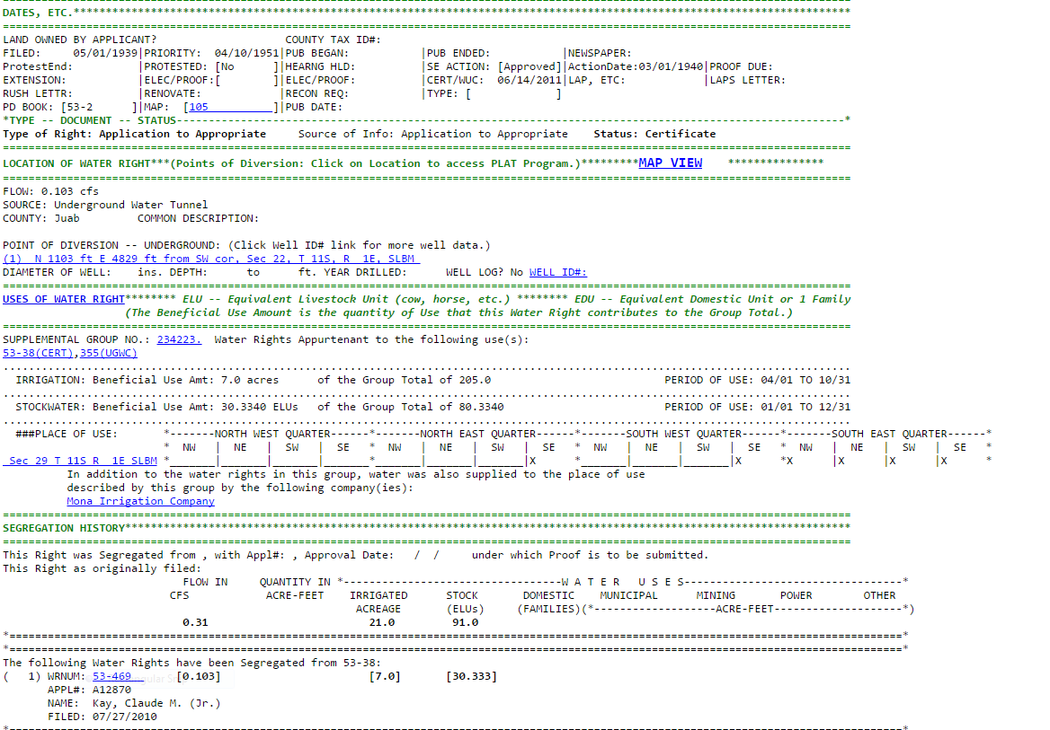
IRRIGATION COMPANY USE NOTE

Slide 22
Water Use Groups may not be 100% correct
Duplicate groups and incomplete groups may exist due to database conversions and entry errors which have occurred over time.
Identifying errors
  Research records
  Send a written request to review the record and include statements as to how it is believed the groups should be modified.

Slide 23

How do you fix database errors

Slide 24
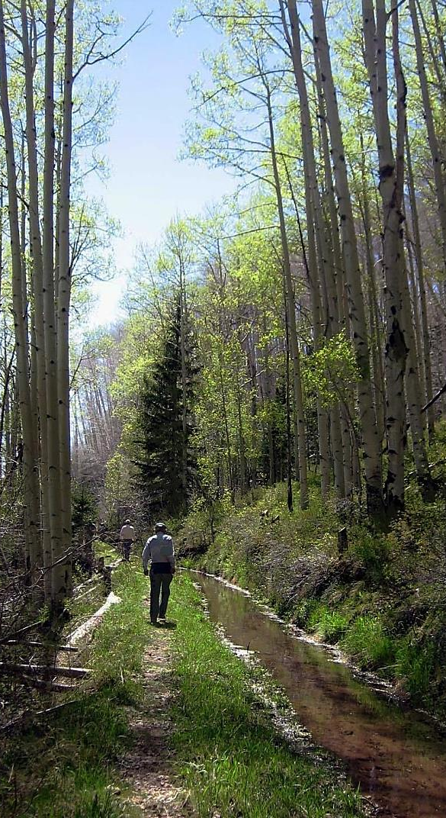
Administrative Rule R655-16
  Declaring Beneficial Use Amounts
    Written request for corrections to be made.
    Declaration of Beneficial Use
      Used to declare the beneficial use amount of a water right in a use group.
    Application for Apportionment of Beneficial Use Amounts.
      The applicant has exhausted all reasonable efforts to complete a Declaration of Beneficial Use.

Slide 25
  Why do you need to define the Beneficial Use Amount (Group Contribution)?
    To file a segregation.
    To file a change application.
  Defining the Beneficial Use Amount of all water rights within a group ensures the amount of water and beneficial use of the individual water rights in the group is properly defined so there won’t be confusion if the rights are used independent of each other.

Slide 26
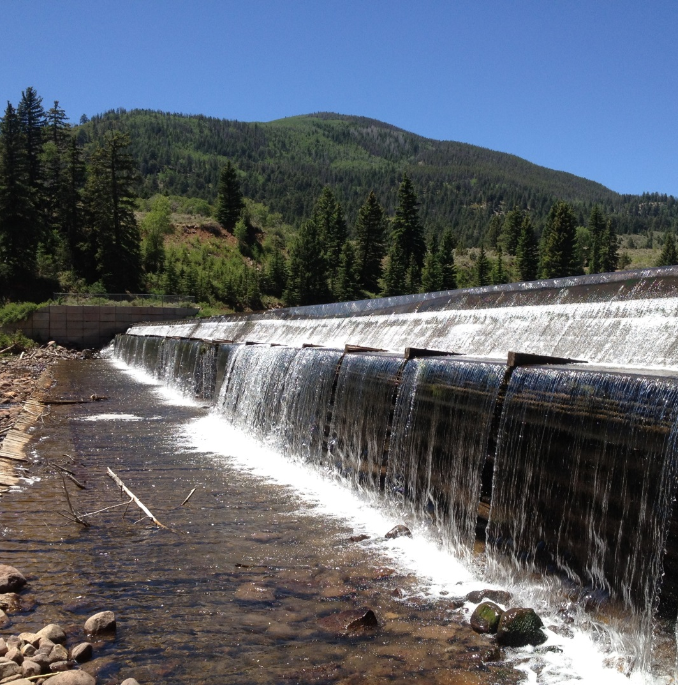
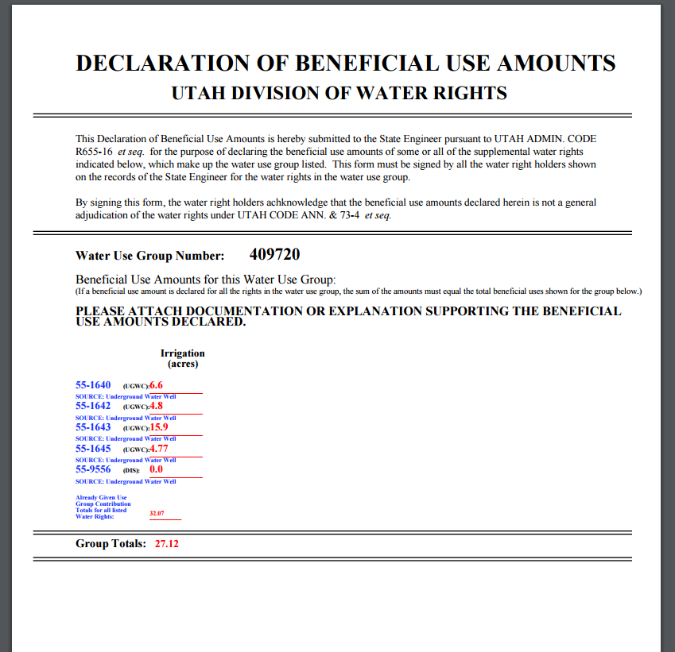

Slide 27
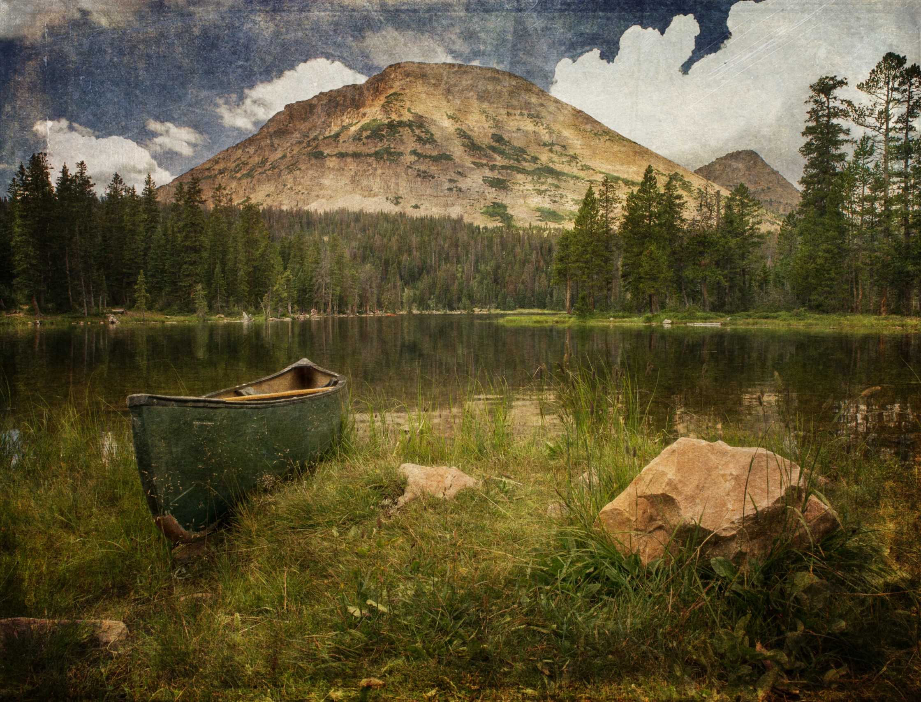
Questions?

